Slide 1
Selling a Small Business
Contributed by: Ray Hanson – Pragma Ventures

Slide 2
What is a Business Intermediary?
Any person who:
Offers, promotes, or lists a business for sale
Introduces the buyer to a seller
Facilitates the transaction
Notes:
At Robbinex – we go much further than that…

Slide 3
What should you expect from a Business Intermediary?
A thorough assessment of the business to:
Provide a comprehensive and reliable valuation range of the business
Prepare the client for the sales process
Identify of obstacles/impediments to selling
Identify value enhancement opportunities
Review, in detail, the 14 alternatives to a sale
Obtain the true “Investment Value”
Notes:
At Robbinex – we go much further than that…

Slide 4
Classifications of Business Brokers

Slide 5
Common Questions
How are businesses valued?
Do rules of thumb work?
Why is a valuation necessary?
Why don’t similar business sell for the same multiples?
What is the biggest impediment to a sale?

Slide 6
What is the Business Worth?
Notes:
At Robbinex – we go much further than that…

Slide 7
THERE ARE 17 DIFFERENT VALUATION METHODS
Broken down into two main categories
Asset Values Earnings Values
If the assets values are worth more than the earnings values, then there maybe little or no goodwill
If the earnings value is higher than the asset values, then there is goodwill

Slide 8
What is my Business Worth?
The “Buyer’s” expectation of profits, in conjunction with the “Buyer’s” assessment of risk associated with the investment, is what drives the value of a business!
Earnings Multiple x Defined Profit
=
Business Value

Slide 9
“The true value of a business
lies in the future
as seen by the buyer.”
D.M. Robbins - 1992

Slide 10
Recast Earnings to Fit “Normal”
Potential Adjustments:
Depreciation/Amortiza- tion
Accounts Receivable
Inventory
Deferred Maintenance
Unused Capacity
Redundant Assets
Charitable Donations
Expensed Capital Items
Family Compensation
Extraordinary Comp.
Cars
Perks (i.e. memberships)
Shareholder Loans
One Time Expenses
Adjust items expensed for favorable tax treatment
Notes:
At Robbinex – we go much further than that…

Slide 11
Variables Impacting Value
Location
Environment
Equipment
Plant and Facilities
Seller Motivation
Historical Trends
Historical Profits
Obsolescence of Product/ services
Management Team
Current Capacity
Intellectual Property
Transaction Structure
Tax Planning
Buyer Motivation
Buyer’s Vision of the Future
Buyer’s Ability to Pay
Other Resources Available to Buyer
Buyer’s Personal Goals/issues
Notes:
At Robbinex – we go much further than that…

Slide 12
Seller Motivation!
Buyers will ask ... “Why are you selling your business?”
Illness
Retirement
Lack of capital
Growth requires more capital
Burnout
Bored
Partnership Dispute
Divorce
Failing business
All equity is tied up in the business
No personal time or money for family and friends
Outside factors-Economic-Political
Business is becoming too risky

Slide 13
Types of Buyers
Buyer Category % of Valuation
  Employees 75 to 90
  Investors 85 to 100
  Golden Hand Shakers 90 to 110
  Entrepreneurs 100 to 120
  Competitors 100 to 200
  Near Competitors 100 to 200
  Customers 100 to 200
  Suppliers 100 to 200

Slide 14
Methods of Payment
Impacts to Value
Cash
Cash equivalent
Secured notes
Unsecured notes
Shares in purchasing company
Consulting agreement
Employment contract
Special lease on assets
Non-compete agreement
License agreement
Royalty program
Earn- out
Notes:
At Robbinex – we go much further than that…

Slide 15
Proper Presentation
  Provide past three year’s results
  Provide a look at the next three years
  Support the future with research
  Anticipate what information the buyer will want and deliver it to him in the presentation
  Share the challenges in the business to build trust with the buyer
Notes:
At Robbinex – we go much further than that…

Slide 16
Considerations in Acquiring a Small Business
How is the business valued?
Does it fit your needs?
Can it sell for a for higher value?
Does it have real estate and is it beneficial for the business?
  Is the purchase for the right reasons, at the right time?
  Can the business grow?
  Is the decision making process based on fact?
  Can the purchase pass a complete Due Diligence review?
  Establish a Transition Team
  What is the exit strategy?

Slide 17

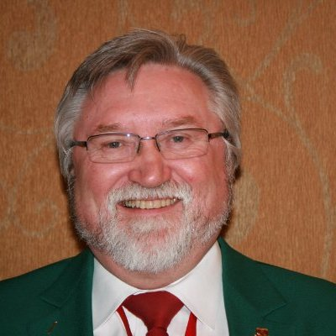
(503) 635-1173
rghanson@pragmaventures.com
Raymond G. Hanson, MCBC, CMEA, BVAL
President, Principal Broker
Master Certified Business Counselor
Business Appraiser
Certified Machinery and Equipment Appraiser
Senior Business Analysis
Business Valuator Accredited in Litigation
Founded Pragma Ventures in 1993
Founded Robbinex of the Pacific Northwest in 2004
Widely respected professional with over 30 years of business transfer and appraising experience
WHAT WE DO:
Exit Planning and Consulting
Business Sales
Mergers and Acquisitions
Buyer Advocacy
Counseling
Business Appraisal
Business Evaluation
Machinery and Equipment Appraisal
Ray Hanson

